Slide 1
Huffman code
Assignment 3

Slide 2
Static Huffman Coding
Static Huffman coding assigns variable length codes to symbols based on their frequency of occurrences in the given message. Low frequency symbols are encoded using many bits, and high frequency symbols are encoded using fewer bits.
The message to be transmitted is first analyzed to find the relative frequencies of its constituent characters.
The coding process generates a binary tree, the Huffman code tree, with branches labeled with bits (0 and 1).
The Huffman tree (or the character codeword pairs) must be sent with the compressed information to enable the receiver decode the message.

Slide 3
Static Huffman Coding Algorithm
Find the frequency of each character in the file to be compressed;
For each distinct character create a one-node binary tree containing the character and its frequency as its priority;
Insert the one-node binary trees in a priority queue in increasing order of frequency;
while (there are more than one tree in the priority queue) {
dequeue two trees t1 and t2;
Create a tree t that contains t1 as its left subtree and t2 as its right subtree; // 1
priority (t) = priority(t1) + priority(t2);
insert t in its proper location in the priority queue; // 2
}
Assign 0 and 1 weights to the edges of the resulting tree, such that the left and right edge of each node do not have the same weight; // 3
Note: The Huffman code tree for a particular set of characters is not unique.
(Steps 1, 2, and 3 may be done differently).

Slide 4
Static Huffman Coding example
Example: Information to be transmitted over the internet contains
the following characters with their associated frequencies:
Use Huffman technique to answer the following questions:
Build the Huffman code tree for the message.
Use the Huffman tree to find the codeword for each character.
If the data consists of only these characters, what is the total number of bits to be transmitted? What is the compression ratio?
Verify that your computed Huffman codewords satisfy the Prefix property.
 | t | s | o | n | l | e | a | Character
 | 53 | 22 | 18 | 45 | 13 | 65 | 45 | Frequency

Slide 5

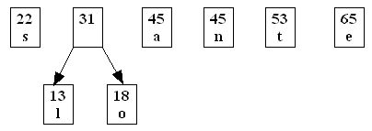
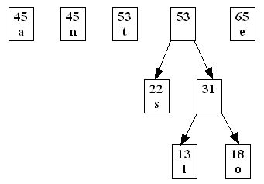
Static Huffman Coding example (cont’d)

Slide 6
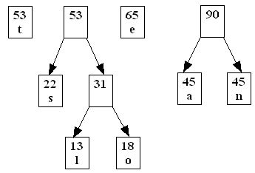
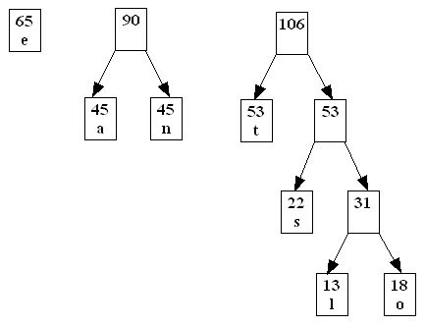
Static Huffman Coding example (cont’d)

Slide 7
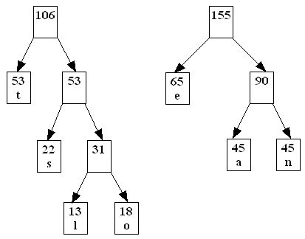
Static Huffman Coding example (cont’d)

Slide 8
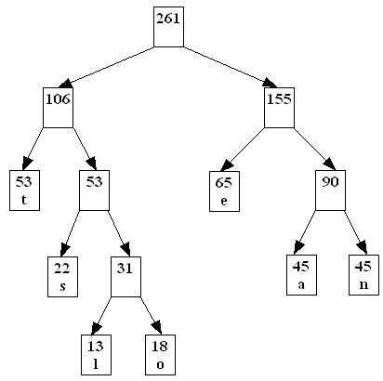
Static Huffman Coding example (cont’d)

Slide 9
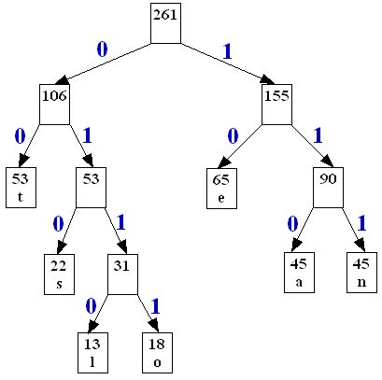
Static Huffman Coding example (cont’d)
The sequence of zeros and ones that are the arcs in the path from the root to each leaf node are
the desired codes:
t | s | o | n | l | e | a | character
00 | 010 | 0111 | 111 | 0110 | 10 | 110 | Huffman codeword

Slide 10
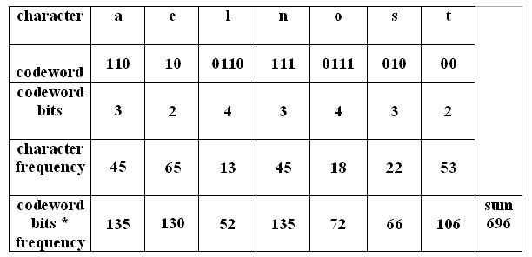
Static Huffman Coding example (cont’d)
If we assume the message consists of only the characters a,e,l,n,o,s,t then the
number of bits for the compressed message will be 696:
If the message is sent uncompressed with 8-bit ASCII representation for the
characters, we have 261*8 = 2088 bits.

